Slide 1
Graph-based Cluster Analysis
Adam DeJans

Slide 2
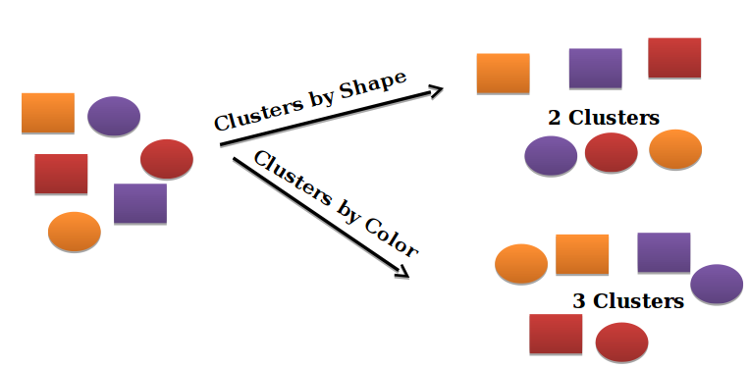
Cluster Analysis
Cluster analysis can be defined as the task of grouping a set of objects in such a way that objects in the same group (called a cluster) are more similar (in some sense or another) to each other than those in other groups (clusters).

Slide 3
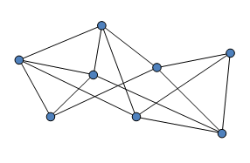
What is a Graph?
A graph is a structure amounting to a set of objects in which some pairs of the objects are in some sense "related".
In one very common sense of the term, a graph is an ordered pair G = (V, E) comprising a set V of vertices, nodes or points together with a set E of edges, arcs or lines, which are 2-element subsets of V

Slide 4
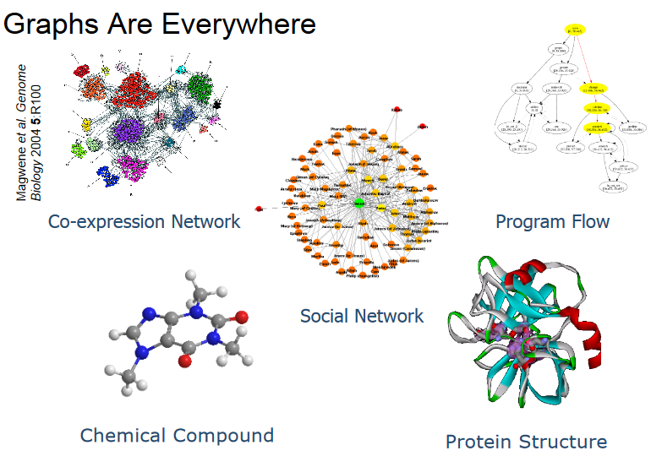
https://www.ethz.ch/content/dam/ethz/special-interest/bsse/borgwardt-lab/documents/slides/BNA09_6_7.pdf

Slide 5
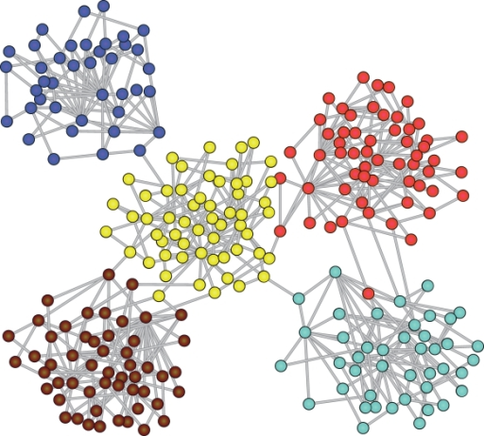
Graph Clustering
There are two types of ways to think about clustering graphs:
Clustering sets of graphs; and
Clustering the nodes/edges of a single graph

Slide 6
Clustering Between Graphs
Clustering Within Graphs
Methods used for clustering between graphs divide a set of graphs into different clusters.
Application: Graphs representing chemical compounds are able to be clustered based on their structural similarity.
Methods used for clustering within graphs divides the nodes of a single graph into clusters.
Application: Graphs representing social networks are able to cluster people with similar hobbies.

Slide 7
Why Graphs?
Graph-based data clustering is an important tool in exploratory data analysis
The applications range from bioinformatics to image processing. The formulation as a graph-theoretic problem relies on the notion of a similarity graph, where vertices represent data items and an edge between two vertices expresses high similarity between the corresponding data items. Then, the computational task is to group vertices into clusters, where a cluster is nothing but a dense subgraph (typically, a clique).

Slide 8
Why Graphs?
Numerous recent publications build on the concept of cluster graphs to uncover the overlapping community structure of complex networks in nature and society.
However, the concept of cluster graphs so far fails to model that clusters may overlap. Consequently, it has been criticized explicitly for this lack of overlaps.

Slide 9
Idea
Objects are represented as nodes in a graph
A weight can be assigned to each edge between two nodes. One interpretation of the weight is a distance between the nodes.
Organize information in large datasets to facilitate users for faster access to required information.

Slide 10
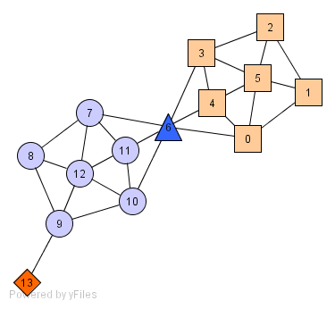
A Social Network Example
Individuals in a tight social group, or clique, know many of the same people
This is regardless of the size of the group
Individuals who are hubs know many people in different groups but belong to no single group
We can think of these as politicians bridging multiple groups
Individuals who are outliers reside at the margins of society
For example, non-social individuals who know very few people or belong to no group

Slide 11
Outline
Three graph-based clustering methods:
k-Spanning Trees Clustering
Vertex (or edge) Betweenness Clustering
Highly Connected Components Clustering

Slide 12
k-Spanning Tree Clustering
Obtains a Minimum Weight Spanning Tree (MWST) of an input graph G
Removes k-1 edges from the MWST
End result is k clusters

Slide 13
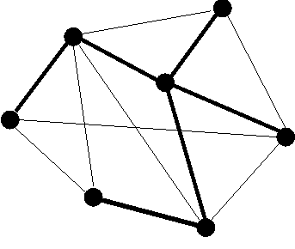
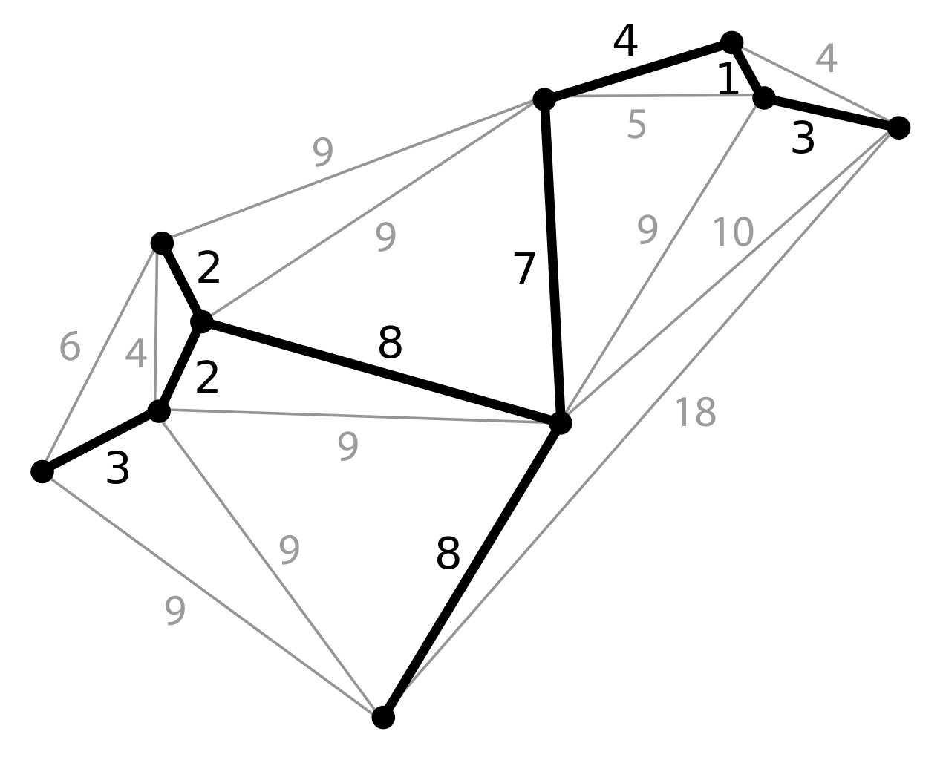
Spanning Trees
Spanning Tree: a connected subgraph with no cycles that includes all vertices in the graph
Minimum Weight Spanning Tree: a spanning tree with minimum total edge weight
The two most famous algorithms for finding the MWST are Kruskal’s algorithm and Prim’s algorithm.

Slide 14
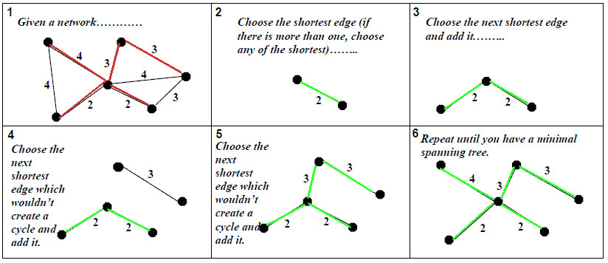
Kruskal’s Algorithm

Slide 15
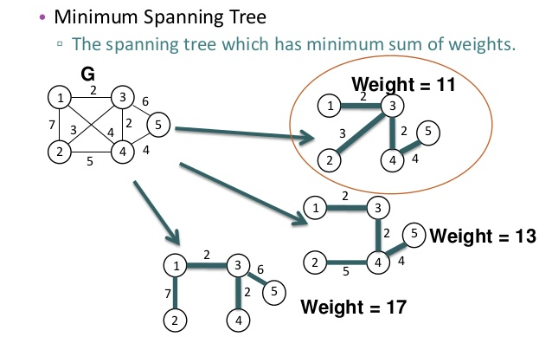
k-Spanning Tree Clustering Example
Given input graph G:

Slide 16
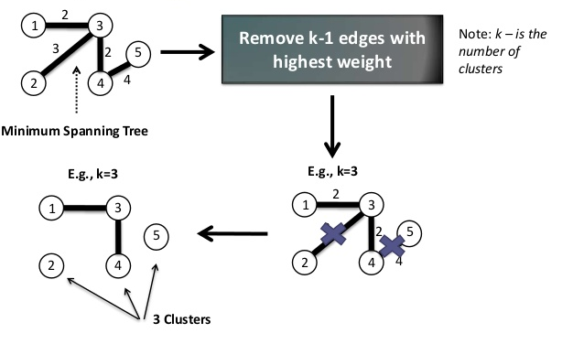
k-Spanning Tree Clustering Example

Slide 17
Spanning Tree Clustering Alternatives
We have seen that deleting the branches in order of maximum weight is one technique to obtain clusters, however there are others:
Delete inconsistent branches; and
Delete by analysis of weights.

Slide 18
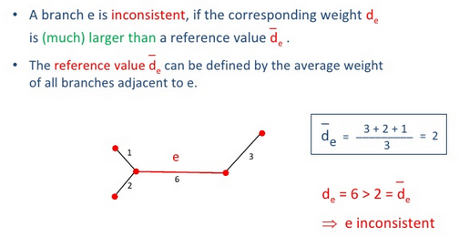
Alternative: Deleting Inconsistent Branches

Slide 19
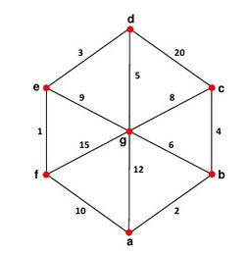
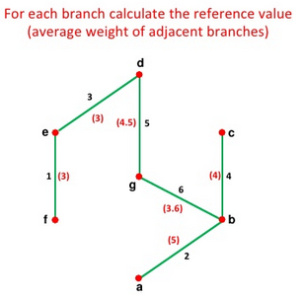
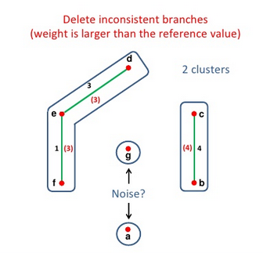
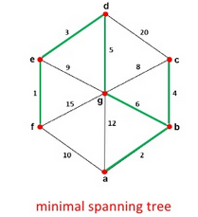
Deleting Inconsistent Branches Example

Slide 20
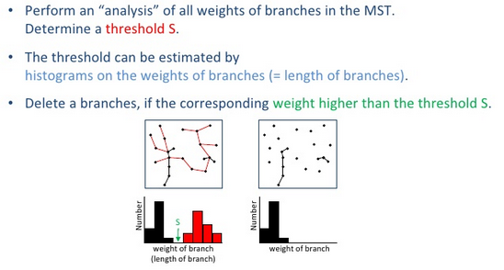
Alternative: Deleting by Analysis of Weights

Slide 21
Shared Nearest Neighbor Clustering
Obtains the Shared Nearest Neighbor Graph (SNN) of an input graph G
Removes edges from the SNN with weight less than a given value, denoted as t

Slide 22
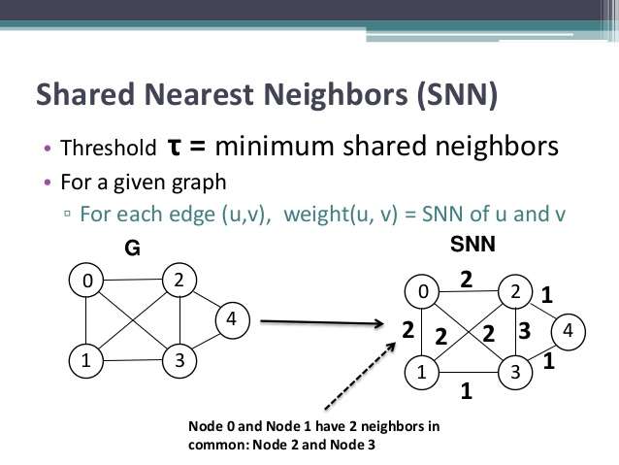
Shared Nearest Neighbor Graph
To obtain the shared nearest neighbor graph, give each edge between two vertices the weight of the number of neighbors that the two nodes share (excluding themselves)

Slide 23
Shared Nearest Neighbor Clustering Example

Slide 24
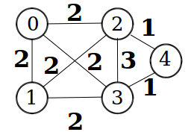
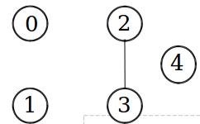
Shared Nearest Neighbor Clustering Example
If the weight is less than T then delete that edge. For example, we may choose T=3

Slide 25
Vertex Betweenness Clustering
Repeatedly disconnected graph at the highest vertex betweenness until the highest vertex betweenness is less than a given value, we denote this value as u.

Slide 26
Vertex Betweenness
This can be defined as the number of shortest paths in a graph that pass through a given node. (This number is usually normalized to be between 0 and 1)
This betweenness quantifies the degree to which a vertex occurs on the shortest path between all the other pairs of nodes.
Vertices with high betweenness can be good starting points to identify clusters.
A vertex can have a low degree, but high betweenness centrality; this captures how much a vertex falls between others.

Slide 27
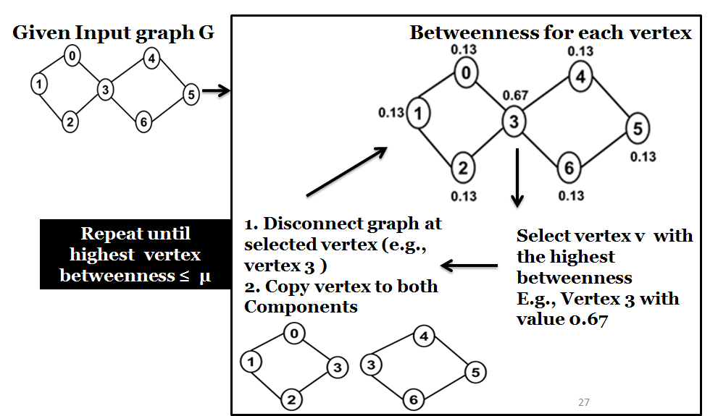
Vertex Betweenness Clustering Example

Slide 28
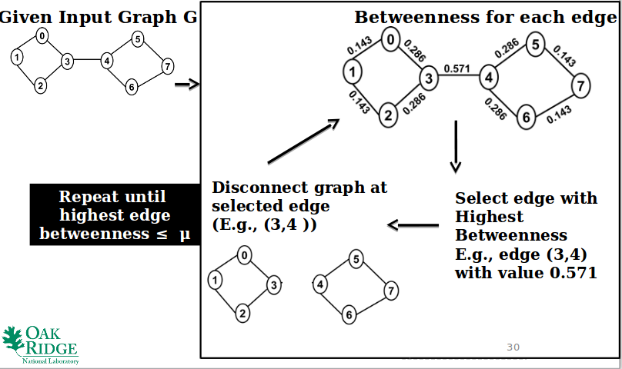
Edge Betweenness Clustering
The same methodology as with vertex betweenness clustering but we use edges.

Slide 29
Highly Connected Components Clustering
While the Edge Connectivity of an inputted graph G is not more than the number of vertices in G divided by 2 divide G using it’s minimum cut.
When the edge connectivity of G is greater the number of vertices divided by 2, output G

Slide 30
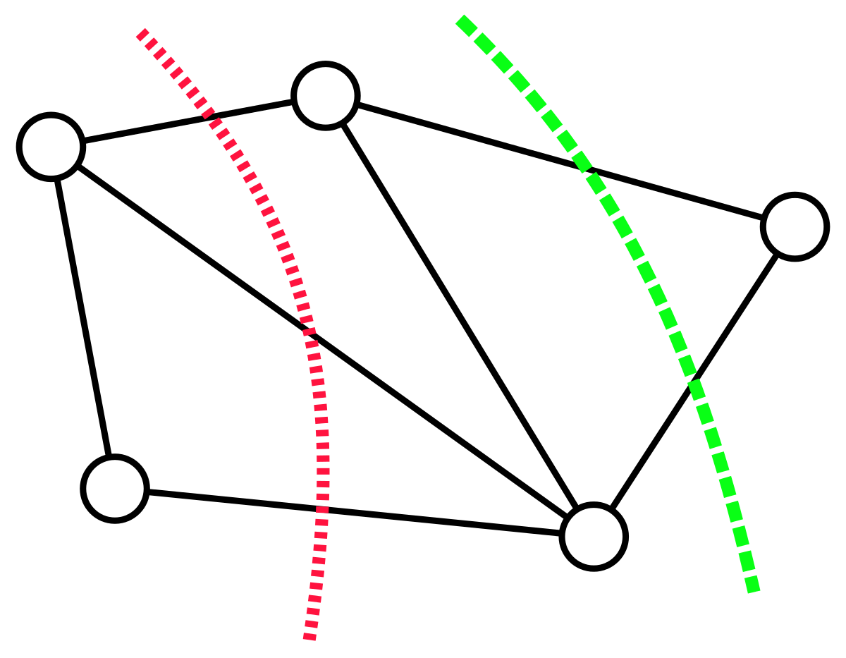
Cut
A cut in a graph is a set of edges whose removal disconnects the graph into multiple components.

Slide 31
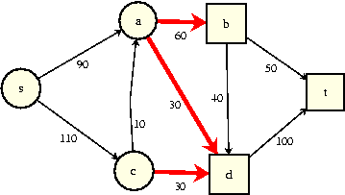
Minimum Edge Cut
The cut of a graph with the smallest cardinality (i.e. the minimum set of edges whose removal disconnects the graph)
Often the Ford-Fulkerson algorithm is used to find the mimumum cut in a graph

Slide 32
Edge Connectivity
The cardinality of the minimum edge cut (i.e., the minimum number of edges that will disconnect a graph)
The edge connectivity here is 3

Slide 33
Highly Connected Subgraphs
A graph G=(V,E), where V is the vertex set and E is the edge set, is highly connected if the edge connectivity of G is greater than |V|/2.
Idea:
If a graph is highly connected, a subgraph of it won’t be part of a different cluster.
If a graph is not highly connected, a subgraph of it may be part of a different cluster.

Slide 34
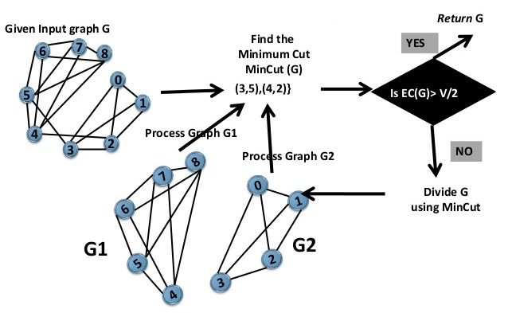
Highly Connected Components Clustering Example

Slide 35
References:
https://www.csc2.ncsu.edu/faculty/...graph-mining.../ppt/Graph_Cluster_Analysis.pptx
North Carolina State University - course lecture
https://www.cse.unr.edu/~mgunes/cs765/cs790f10/Lect12_GraphMining.ppt
University of Nevada, Reno - cs765 Graph Mining Lecture
Graph Clustering Survey Paper
Satu Elisa Schaeffer
Science direct
https://ac.els-cdn.com/S1574013707000020/1-s2.0-S1574013707000020-main.pdf?_tid=189fecea-d476-11e7-9a9b-00000aab0f26&acdnat=1511899114_8b020e3ce1e96ee826d53a2b5a0bf6aa
https://www.slideshare.net/dumbterminal/clustering-43834317
https://www.slideshare.net/ssakpi/graph-based-clustering

Slide 36
Questions?
End of presentation

Slide 37
Maximal Clique Clustering
https://www.youtube.com/watch?v=132XR-RLNoY
Take any single vertex in a graph as a subset
Add as many vertices to this subset (which are adjacent to every other vertex in it), as possible
If subset is not already reported, report as maximal clique
Remove the vertex used in step 1 from further considerations
Repeat step 1 to 4 for all vertices in the graph

Slide 38
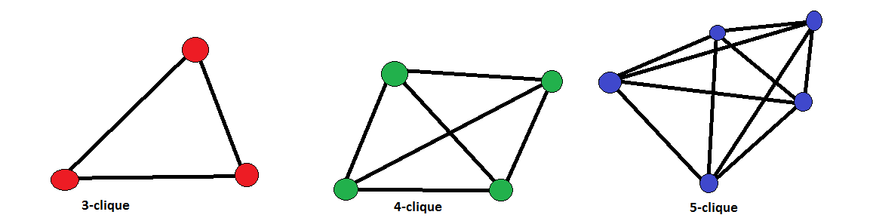
Clique
Subgraph with edges between all nodes

Slide 39
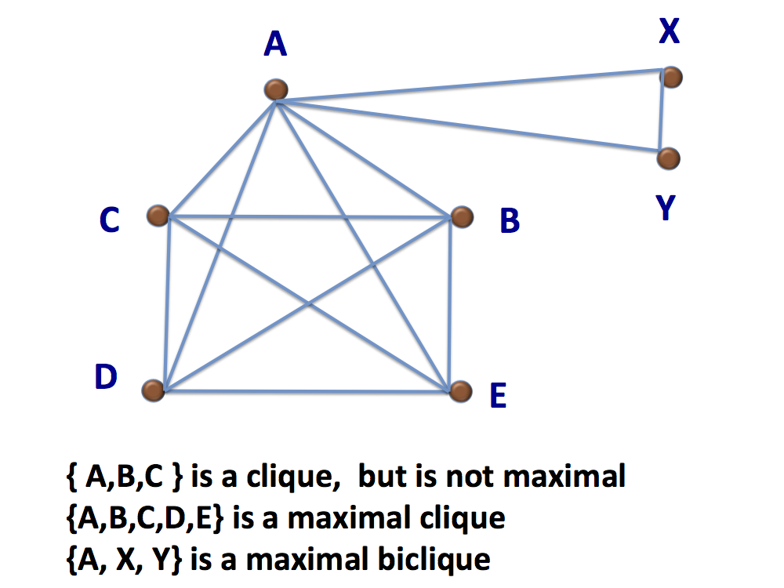
Maximal Clique
A clique that is not part of a larger clique

Slide 40
Maximal Clique Clustering Example
Bron and Kerbosch Algorithm

Slide 41
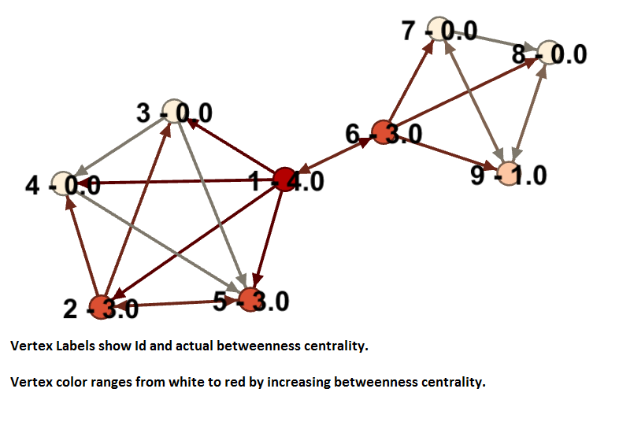
Vertex Betweenness Graph
******GET A NEW IMAGE AND EXAMPLE*******

Slide 42
(i.e., when the distance from v to w is no larger than from v to any other object in the set of vertices).
SNN

